Slide 1
CLAS 220 Introduction to Classical Mythology
Ovid: Metamorphoses 5-8

Slide 2
Quiz Question
What is the name of Perseus’ rival for Andromeda’s hand?
Damon
Philemon
Achelous
Phineas

Slide 3
Quiz Question
2. Which mortal woman claims she can weave as well as Minerva?
Arethusa
Arachne
Philomela
Procne

Slide 4
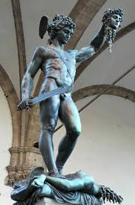
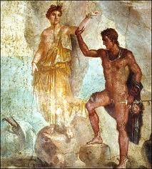
4. Perseus Cycle (cont’d)

Slide 5
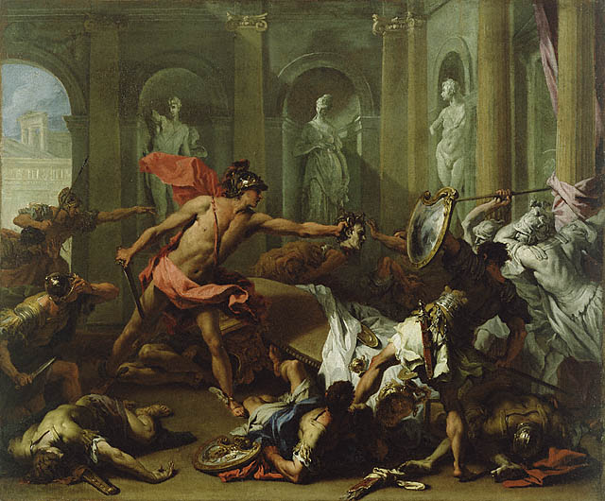
4. Battle at the House of Cepheus
When Perseus wins Andromeda, she’s already engaged to Phineus
His allies come in the thousands to attack Perseus, who kills many of them in person
Then he finishes off the rest with the Medusa’s head

Slide 6
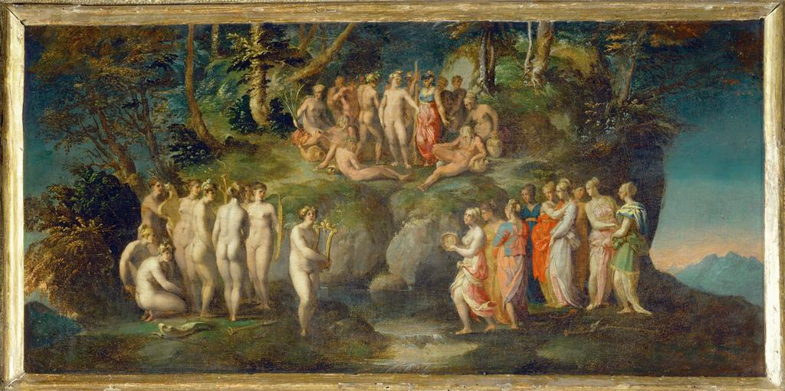
4. The Muses and the Pierides
Minerva moves from helping Perseus to talking with the Muses
In other sources, Pierides is just another name for the Muses
Here, a rival group of nine women, who also sing
Competition between Muses and Pierides ends badly for the latter, who turn into magpies
Pierides sing of the Gigantomachy
Muse Calliope sings of rape of Proserpine

Slide 7
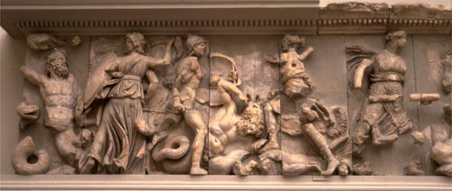
4. The Gigantomachy
Important story from mythic prehistory, of attempt by Giants to defeat the Olympian Gods
Classic case of the kind of song that poets like Ovid and Virgil (and Callimachus) don’t like

Slide 8
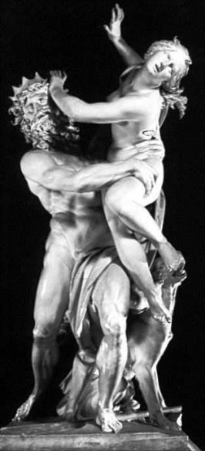
4. The Rape of Proserpine
Begins with reference to defeat of Typhoeus in Gigantomachy (hint to Pierides); he is buried under Sicily
Basically the same story we get in Homeric Hymn to Demeter
Addition of nymphs:
Cyane (who dissolves into water), nonetheless hints about Proserpine’s whereabouts
Arethusa, who explains to Ceres that it’s Dis (Hades) who has captured Proserpine

Slide 9
Quiz Question
3. Who boasts of having had more children than Leto?
Amphion
Triptolemus
Niobe
Marsyas

Slide 10
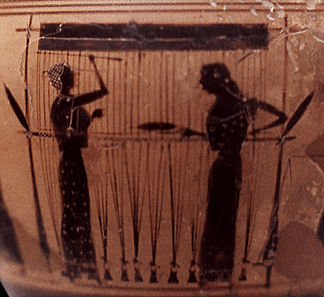
5. Contests of Gods and Men

Slide 11
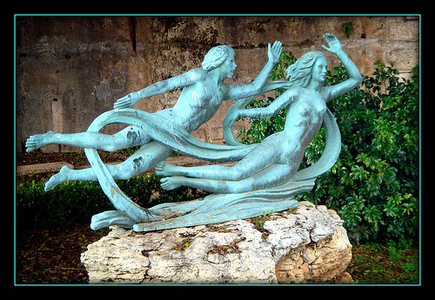
5. Arethusa
After cameo in story of rape of Proserpine, Ceres returns to ask her to tell her story
She was a nymph pursued by Alphaeus, a river god, who falls in love with her when she bathes in him
To escape him, turns into spring and flees to Sicily
Legendarily, her spring on Sicily is connected under the Mediterranean with his river in Greece

Slide 12
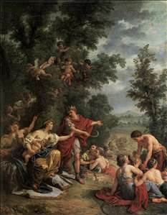
5. Triptolemus
Mentioned in Homeric Hymn to Demeter
Worshipped as a hero in Eleusinian Mysteries sacred to her
“culture hero” of agriculture
In Ovid, a prince
When he tries to spread knowledge of agriculture to Scythia (modern Ukraine), the local king Lyncus is jealous and tries to kill Triptolemus
Lyncus turned into lynx

Slide 13
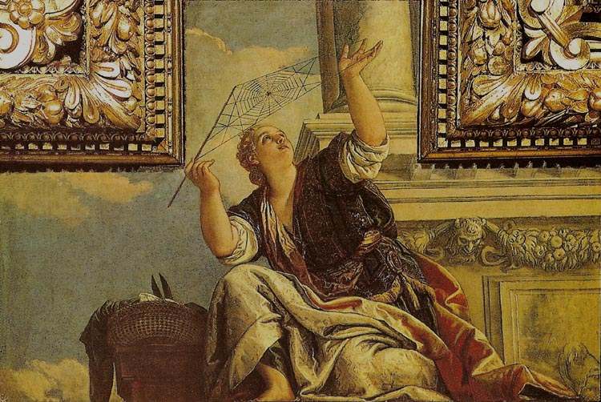
5. Arachne
More on the theme of rivalling the gods
Claims to be a better weaver than Minerva
Minerva initially appears disguised as old woman; but Arachne still challenges her when she reveals herself
Arachne turned into spider

Slide 14

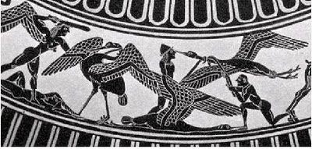
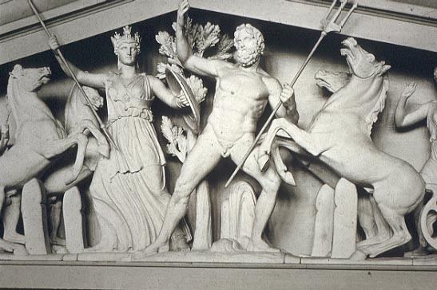
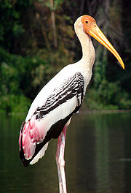
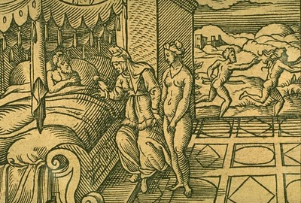
5. Minerva’s Tapestry
Rhodope and
Haemon
Pygmies and Cranes
Antigone Turned
Into a stork
Cinyras and Myrrha
Athena and Poseidon
Compete to Name Athens

Slide 15
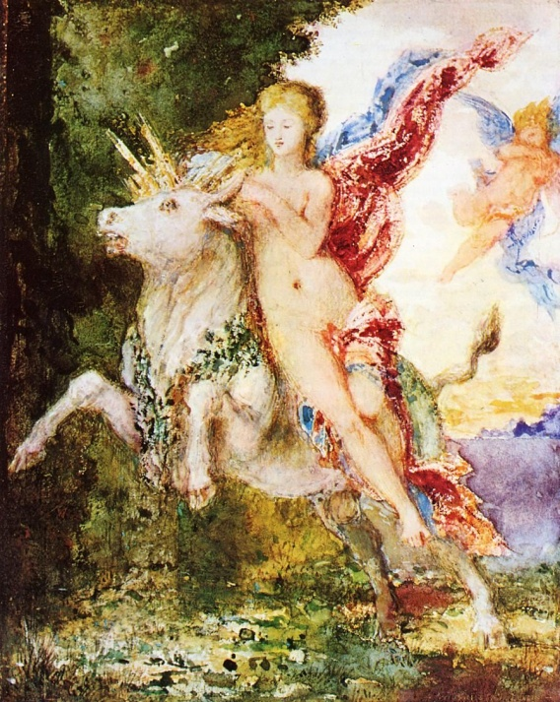
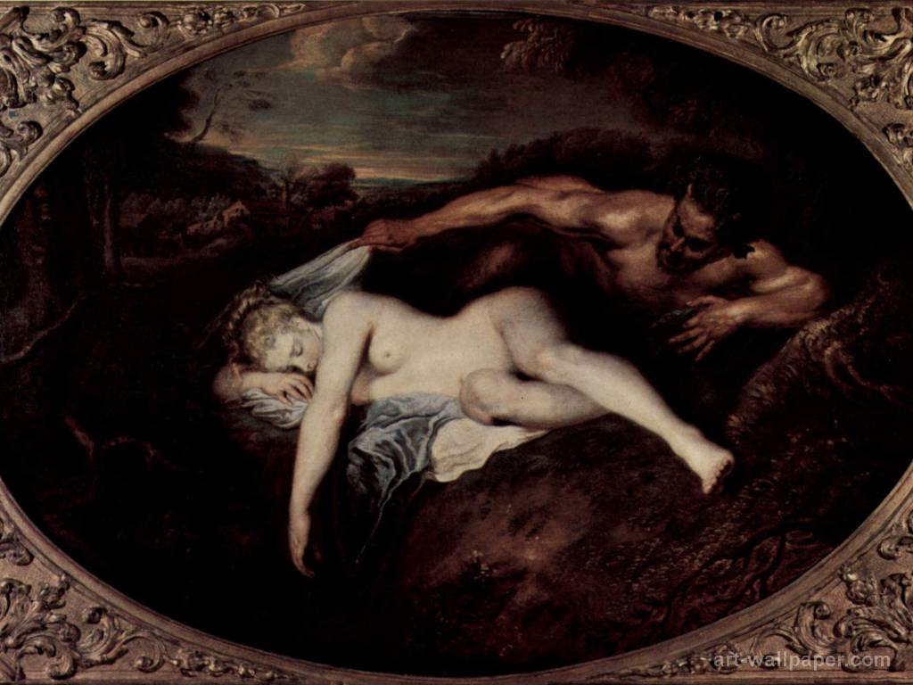
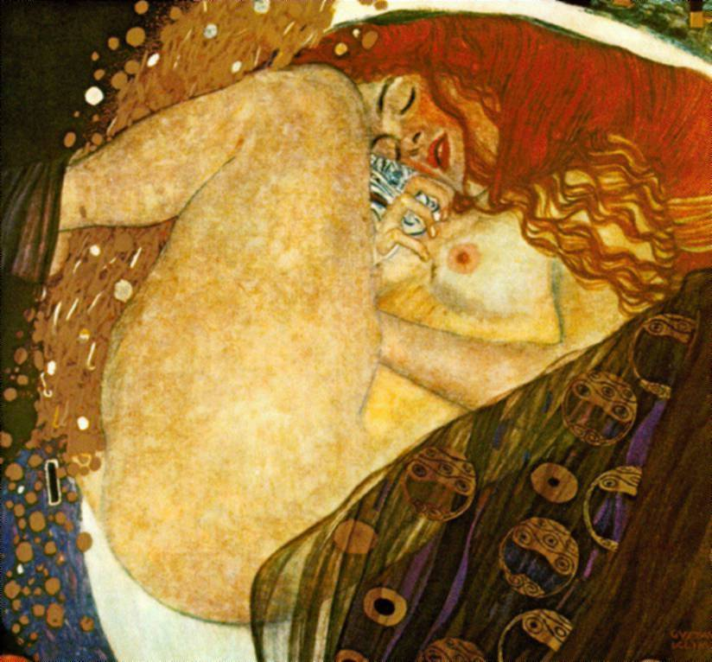
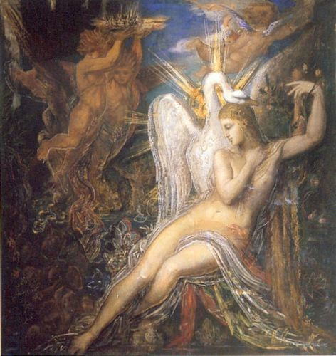
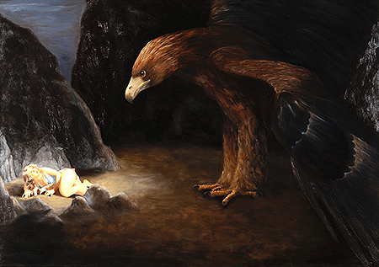
5. Arachne’s Tapestry
etc…

Slide 16
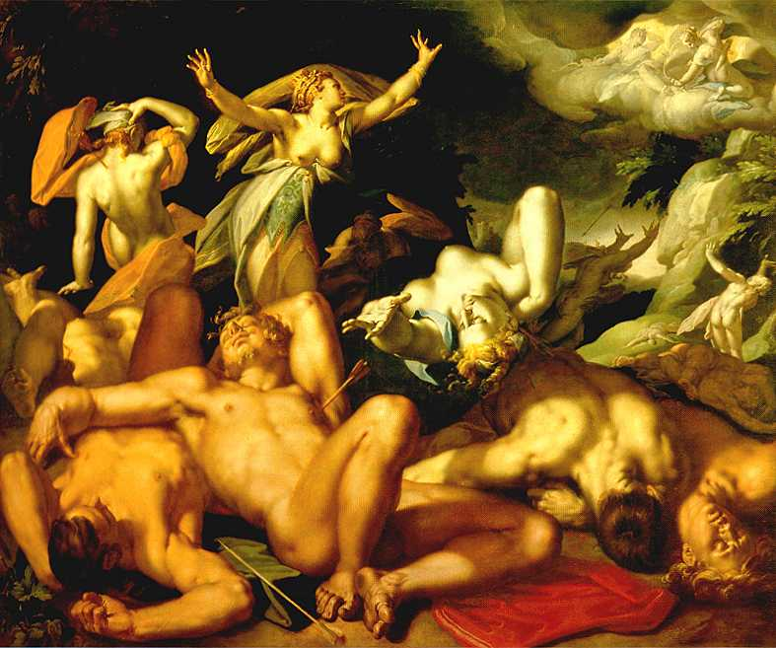
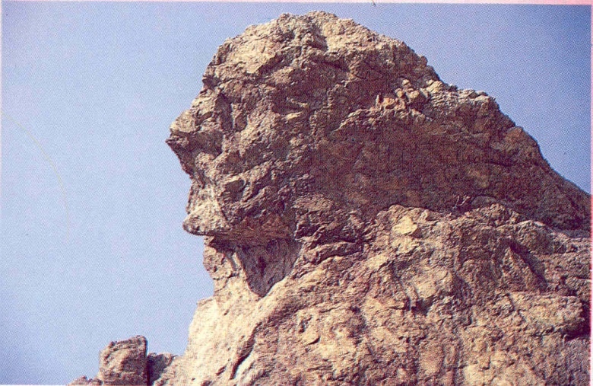
5. Niobe
more rivalry with gods
Wife of Amphion, who along with his twin brother Zethus is one of the founders of Thebes in an alternative version
Has seven sons and seven daughters,
Brags that she has more divine genealogy than Leto; plus, she’s prettier and has more kids
Leto gets her children to kill Niobe’s fourteen children
Niobe weeps for so long that she turns to stone

Slide 17
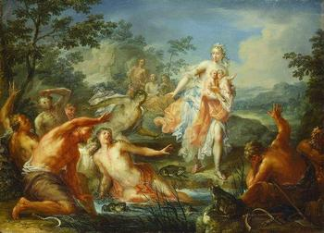
5. The Lycian Peasants
Also doubt the divinity of Leto
Turned into frogs
Comic and obscure version of Niobe story
Their voice is harsh, their throats are puffed and swollen;
their endless insults stretch their big mouths wide;
their loathsome heads protrude, their necks seem lost;
their backs are green; their bodies' biggest part,
their bellies, white; and in the muddy pond
they leap and splash about -- new-fangled frogs.

Slide 18
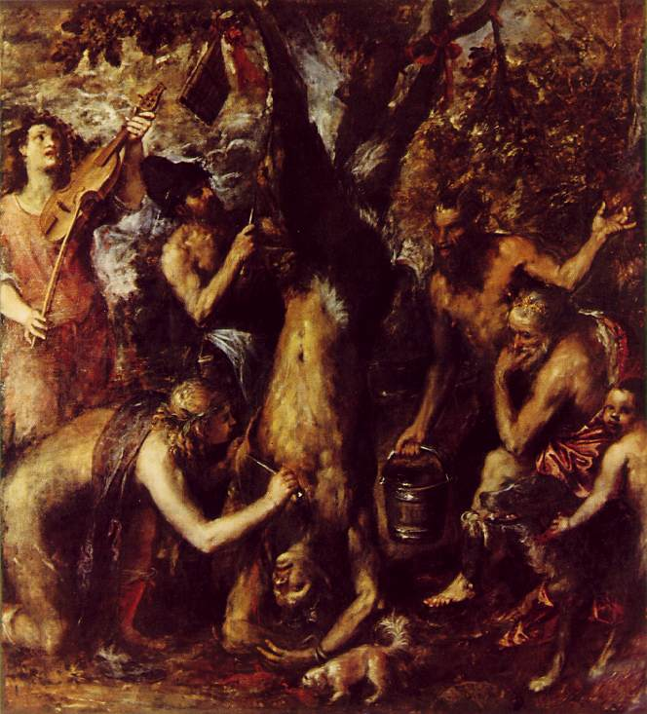
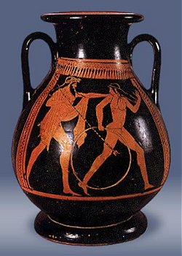
5. Marsyas and Pelops
Marsyas another case of rivalry with gods
Claims to be better flute-player than Apollo
Flayed alive
Pelops becomes transition to new set of stories
Mourns for Niobe
Served to gods by father Tantalus
Only god to eat part of him was Ceres, distracted with grief over Proserpine
Reconstituted, with ivory shoulder to replace part eaten
Other mourners come to Niobe, except from Athens….

Slide 19
Quiz Question
4. Which Thracian king rapes his wife’s sister?
Tereus
Theseus
Aglauros
Achelous

Slide 20
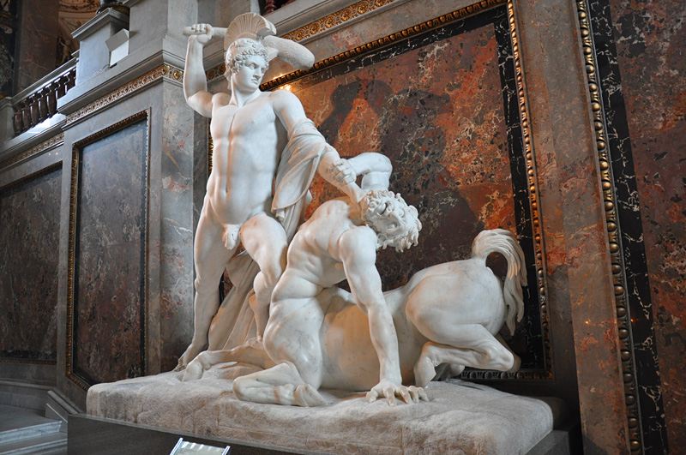
6. Athenian Cycle

Slide 21
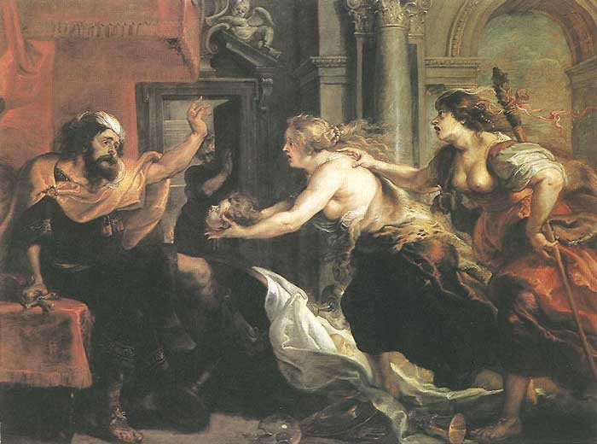
6. Tereus, Procne and Philomela
Thracian King Tereus marries Procne, daughter of Athenian king
One day, Procne wants to see her sister Philomela, so gets Tereus to go to Athens to collect her
Tereus falls in love with Philomela; persuades her to come back with him
Rapes her and cuts out her tongue so that she can’t confess; strands her in forest cottage
Philomela sends word to Procne through tapestry (words, not pictures)
Procne retrieves Philomela by pretending to be Bacchant
Gets revenge by killing own son (Itys) and serving him for dinner to Tereus
All of them are turned into birds

Slide 22
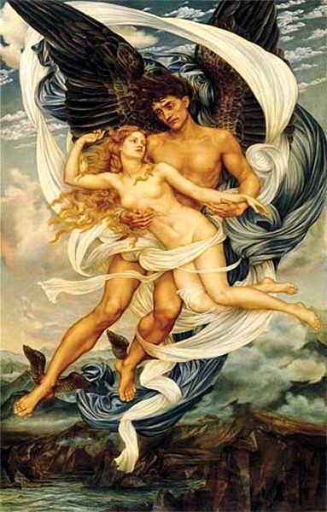
6. Boreas and Orithyia
Boreas – north wind
Orithyia – daughter of Erechtheus, king of Athens
Boreas falls in love with Orithyia; but takes her by force because that feels more natural to him
Their sons join the Argonauts
Speaking of which….

Slide 23
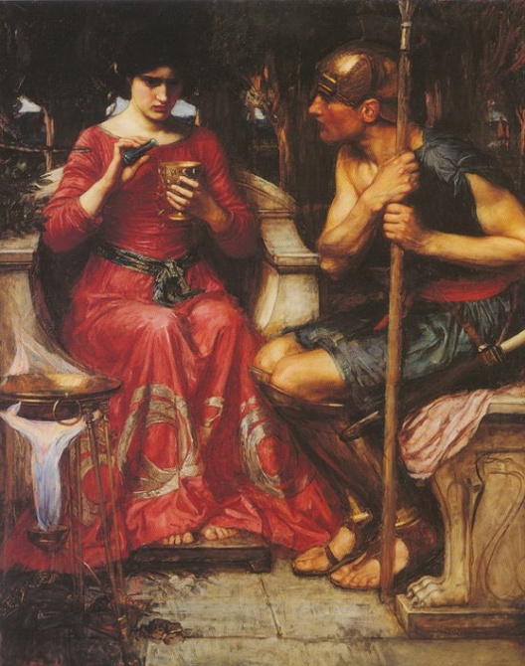
6. Medea and Jason
Cf. Euripides’ Medea,
Cf. also Apollonius of Rhodes, Argonautica
Ovid also wrote one tragedy, the Medea (lost)
Interested less in all the adventures along the way than in Medea as character
Shows her helping Jason to get golden fleece (defeating brazen fire-breathing bulls; defeating Spartoi; charming dragon to sleep), but in each of these cases the effort seems pretty straightforward
Bypasses her murder of her brother

Slide 24
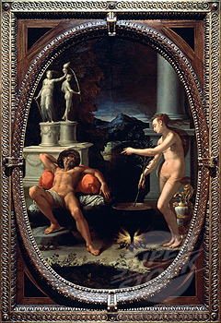
6. Medea and Aeson
Optional episode, not found in many other retellings, where Medea restores Jason’s father to youth by chopping him into small pieces and boiling him with secret herbs
Ovid gives loving detail about where she goes to collect the herbs.
And seeing this Medea drew her blade
and slit the old king's throat and let the blood
run out and filled his veins and arteries
with her elixir, and when Aeson drank,
through wound and lips, at once his hair and beard,
white for long years, regained their raven hue;
his wizened pallor, vanquished, fled away
and firm new flesh his sunken wrinkles filled,
and all his limbs were sleek and proud and strong.
Then Aeson woke and marvelled as he saw
his prime restored of forty years before.

Slide 25
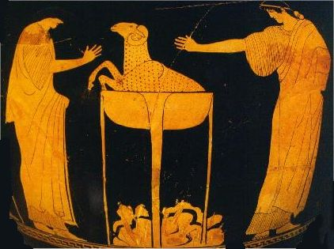
6. Medea and Pelias
Then she tricks Pelias’ daughters into killing their father using the same magic, but without the herbs
Gains their confidence by demonstrating on a ram
So urged, each in her loving loyalty
vied in disloyalty, and each, in fear
of guilt, was guilty. Yet not one of them
could bear to see her blows. They looked away;
the wounds they gave, those savage wounds, were blind.
The old king, streaming blood, yet raised himself
upon his elbow; butchered as he was,
he tried to rise from bed. Amid those swords,
so many swords, he stretched his pallid arms,
"Daughters, what are you doing? What has armed you,"
he cried," to kill your father?" Their hearts failed;
their hands fell. As he spoke again, the witch
cut short the words and windpipe in his throat
and plunged him, butchered, in the boiling pot.

Slide 26
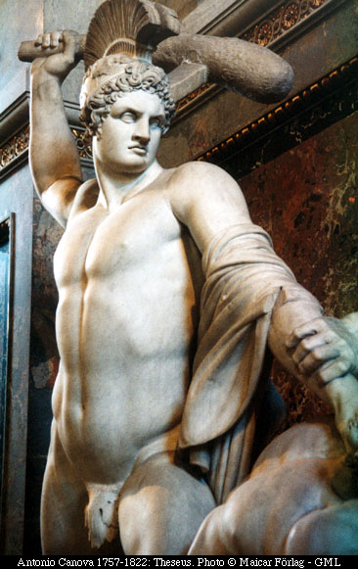
6. Theseus
The great hero of Athens; center of many great adventures not narrated here
Instead, he becomes a foil and audience for a variety of other stories
Part of Ovid’s poetics: avoid the obvious stories, go for the more obscure ones; ignore things not easily connected to transformation
the story here begins with Medea's attempt to poison Theseus as Aegeus' son -- transition from previous section
the Athenian people celebrate Theseus' many deeds(described in passing, like killing Procrustes)
... but trouble still looms, because war is threatening with Minos of Crete

Slide 27
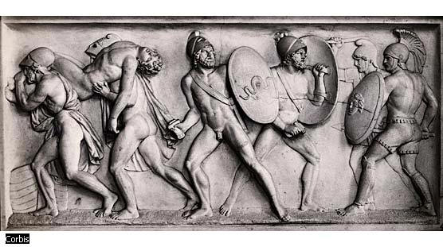
6. The Myrmidons
In the Iliad, Akhilleus’ warriors
In Ovid, they begin as ants (myrmex=ant); Zeus turns them into warriors in order to repopulate Aegina after plague to help King Aeacus (Ajax’s father, Akhilleus’ uncle)
Become allies in the war with Crete

Slide 28
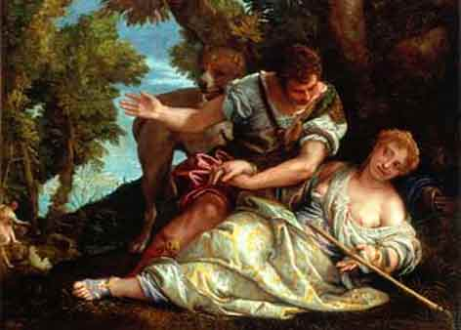
6. Cephalus and Procris
A classic story of love and deceit
Cephalus loves and marries Procris (another daughter of Erechtheus)
Eventually grows anxious about her fidelity; leaves her then returns in disguise to test her
When he finally succeeds, he reveals himself, then she flees
Eventually they get back together happily
Then she begins to doubt him
When he’s out hunting, he keeps calling suggestively to Zephyr (the west wind)
She spies on him one day; he throws javelin at her by accident, killing her
But not before they can have tearful reconciliation

Slide 29

“La mia Dorabella capace non è” from Mozart, Così fan tutte

Slide 30
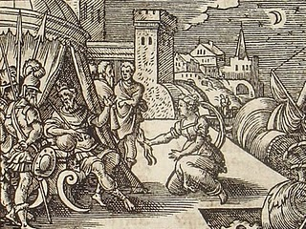
6. Scylla and Minos
Minos (king of Crete) is besieging city of Megara, ruled by King Nisus
Nisus’ daughter, Scylla, falls in love with Minos from a distance, decides to betray her father and her city to be with him
He turns her down
In shame she becomes a bird

Slide 31
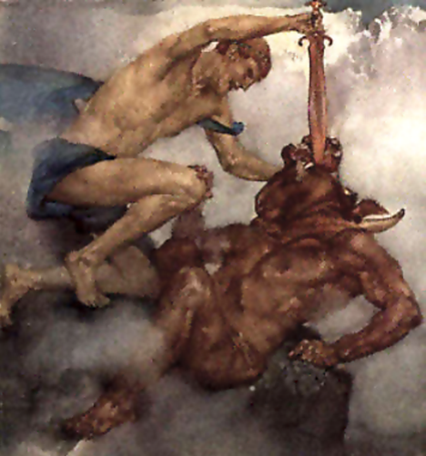
6. The Minotaur
Minos’ wife Pasiphae falls in love with bull, gets Daedalus to make artificial cow so that she can sleep with bull
Their progeny the Minotaur
Trapped in labyrinth by Daedalus; requires annual human sacrifice from Athens
Theseus sent to defeat Minotaur, does so with help of Ariadne, Mino’s daughter
Sails away with Ariadne, but has to leave her behind on Naxos for Dionysus
Tale told very briefly by Ovid: too obvious

Slide 32
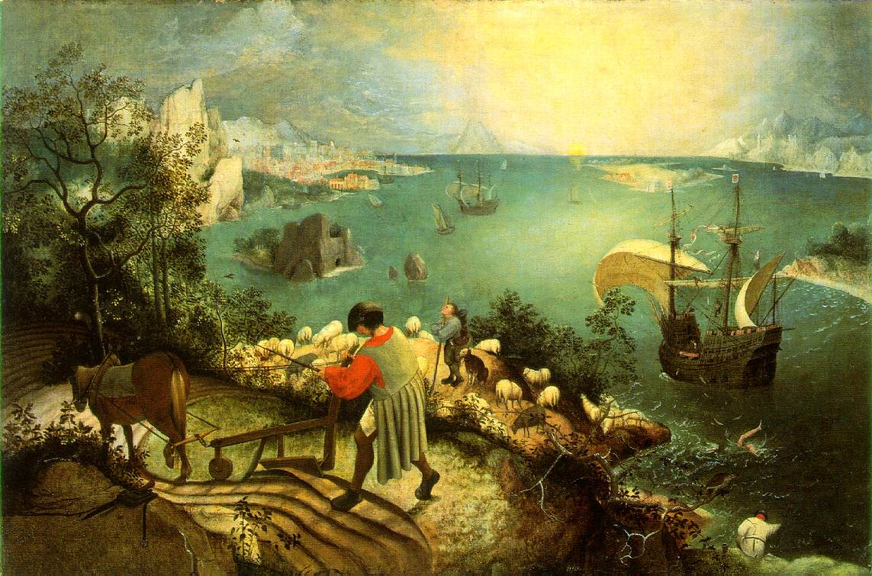
6. Daedalus and Icarus
“An angler fishing with his quivering rod,
A lonely shepherd propped upon his crook,
A ploughman leaning on his plough, looked up
And gazed in awe, and thought they must be gods
That they could fly.”

Slide 33
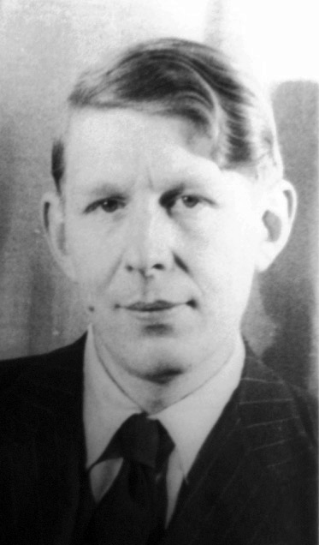
“Musee des Beaux Arts,” W. H. Auden
About suffering they were never wrong,
The old Masters: how well they understood
Its human position: how it takes place
While someone else is eating or opening a window or just walking dully along;
How, when the aged are reverently, passionately waiting
For the miraculous birth, there always must be
Children who did not specially want it to happen, skating
On a pond at the edge of the wood:
They never forgot
That even the dreadful martyrdom must run its course
Anyhow in a corner, some untidy spot
Where the dogs go on with their doggy life and the torturer's horse
Scratches its innocent behind on a tree.
In Breughel's Icarus, for instance: how everything turns away
Quite leisurely from the disaster; the ploughman may
Have heard the splash, the forsaken cry,
But for him it was not an important failure; the sun shone
As it had to on the white legs disappearing into the green
Water, and the expensive delicate ship that must have seen
Something amazing, a boy falling out of the sky,
Had somewhere to get to and sailed calmly on.

Slide 34
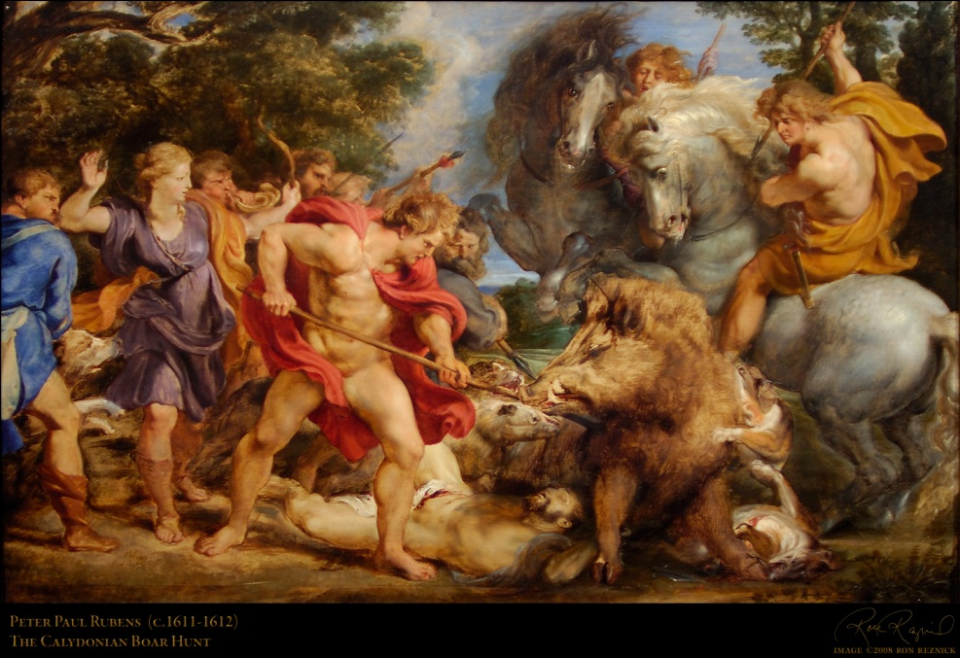
6. The Calydonian Boar-Hunt
One of the great Panhellenic myths, bringing heroes together from all over Greece, including Theseus
Calydon has neglected Diana, she gets her revenge by sending a giant boar
Episode somewhat comic, as most of the heroes pretty inept
Also romantic: Meleager, prince of Calydon, falls in love with Atalanta, woman-warrior who kills bull
Meleager then kills his uncles for trying to claim victory
Cf. different version in Iliad

Slide 35
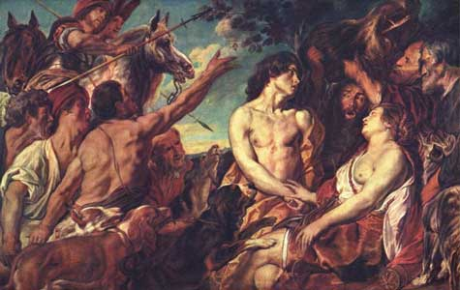
6. Meleager and Althaea
Althaea, Meleager’s mother, is torn between loyalty to son and to brothers; in the end chooses brothers
Fates told her her son would last as long as a particular log; she throws log on fire and he burns up
More interest in women working through complex psychological situations
I would, I want -- and can't. What shall I do?
before my eyes I see my brother's wounds,
the picture of that slaughter -- yet, again,
a mother's loyal love rends my resolve.

Slide 36
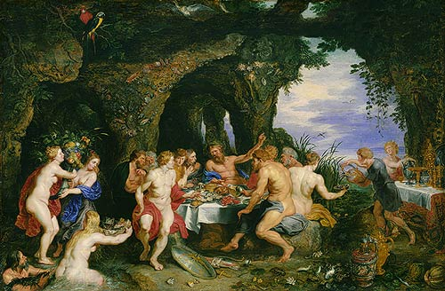
6. Achelous and the Nymphs
Theseus, in returning home, runs into river Achelous, who is flooding
Achelous oldest and greatest of rivers
River invites Theseus into his home to hear stories
Includes Achelous’ own story; more nymphs chased by god, then turned into islands to escape him

Slide 37
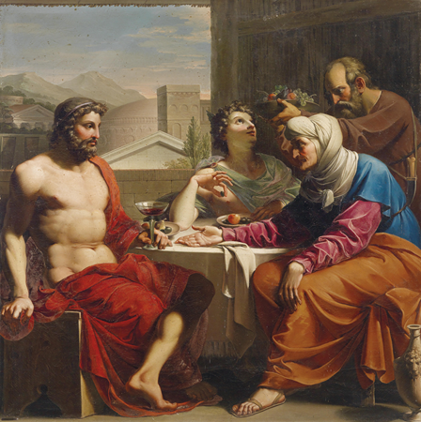
6. Baucis and Philemon
Happier story of gods and men
Jupiter and Mercury, angry at men, visit earth to test them
Arrive at cottage of Baucisd and Philemon, elderly peasants
Baucis and Philemon feed them well despite their poverty, willing to kill only goose for guests
Gods reward them by sparing them from flood;
Also grant them wish to die together
Which they do, and turn into tree with two trunks

Slide 38
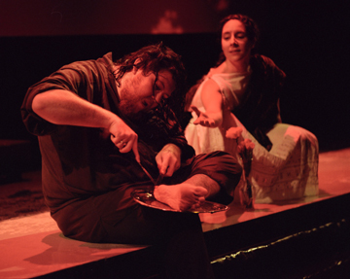
6. Erysichthon and his Daughter
Opposite story; about greed
Erysichthon is a bad guy
Cuts down sacred tree
Punished by Ceres with perpetual hunger
Sells daughter into slavery
But she’s a shape-shifter so she turns into fisherman and escapes
Erysichthon turns this into a regular scam
Eventually becomes so hungry that he starts eating himself.

Slide 39
Quiz Question
5. What is the name of Daedalus’ son?
Iphis
Iolanthe
Itys
Icarus

